Slide 1
Introduction to TypeScript
TypeScript Overview
General idea, relation to JavaScript, history.
Types
Basic types.
Interfaces And Classes
Understanding Interfaces and classes, defining new interfaces and classes.
inheritance and implementation.
Functions
Functions, arrow functions and accessors.
Generics And Generics Constraints

Slide 2
Advanced TypeScript
Equality
References
Null and Undefined
this Key word and Closure
var, let and const key words
Rest Parameters
Spread operator
Destructuring
for, of, in key words and iterators
Template strings
Generators
Promise and async await key words
Enums and union types
Casting and type assertion
typeof and instanceof key words
And much more…

Slide 3
TypeScript Overview
TypeScript is a superset of JavaScript that compiles to clean JavaScript output.
JavaScript program is also a valid TypeScript program.
TypeScript provides static typing through type annotations to enable type checking at compile time.
TypeScript was first made public in October 2012 (at version 0.8), after two years of internal development at Microsoft.
TypeScript adds optional types to JavaScript that support tools for large-scale JavaScript applications for any browser, for any host, on any OS.

Slide 4
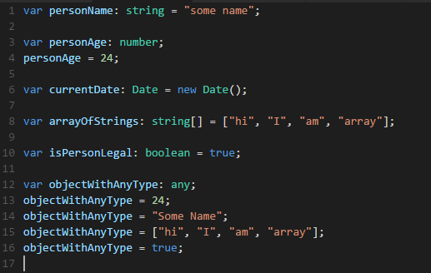
Types
TypeScript has a type system.
TypeScript provides static typing, meaning it only effects on compile time.
Examples:

Slide 5
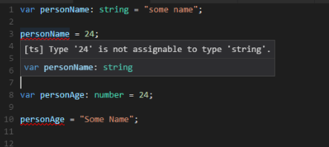
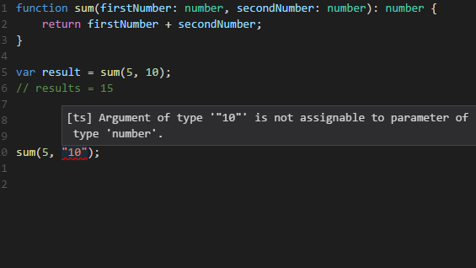
Types

Slide 6
Types
The basic types are
boolean
number
string
any
void
[]
Date
object

Slide 7
Types
boolean
The most basic datatype is the simple true/false value, which JavaScript and TypeScript call a boolean value.
number
As in JavaScript, all numbers in TypeScript are floating point values.
These floating point numbers get the type number.
string
Just like JavaScript, TypeScript also uses double quotes (") or single quotes (') to surround string data.

Slide 8
Types
[] – Array
TypeScript, like JavaScript, allows you to work with arrays of values.
let list: number[] = [1, 2, 3];
any
We may need to describe the type of variables that we do not know when we are writing an application.
These values may come from dynamic content, e.g. from the user or a 3rd party library.
In these cases, we want to opt-out of type-checking and let the values pass through compile-time checks.
To do so, we label these with the any type

Slide 9
Types
void
void is a little like the opposite of any, the absence of having any type at all.
You may commonly see this as the return type of functions that do not return a value.
function warnUser(): void {
console.log("This is my warning message");
}

Slide 10
Interfaces
Interfaces provide a way to define the expected structure of the variable.
Unlike static languages, there is no need to explicitly implement the interface – only match the interface structure (“duck typing”).
Interfaces have no equivalent in JavaScript.

Slide 11
Interfaces
Examples:
interface Animal {
color: string;
name: string;
owner: string;
height: number;
isDomestic: boolean;
}

Slide 12
Interfaces
Optional Properties
Not all properties of an interface may be required. Some exist under certain conditions or may not be there at all.
interface Animal {
color: string;
name: string;
owner?: string;
height?: number;
isDomestic?: boolean;
}

Slide 13
Classes
Classes are the main building blocks of OOP.
Starting with ECMAScript 2015, also known as ECMAScript 6, JavaScript also supports object-oriented class-based approach. In TypeScript, developers can use these techniques, and compile them down to JavaScript that works across all major browsers and platforms.
Classes can derive from other classes, implement interfaces, and have access modifiers.

Slide 14
Classes
Examples
Class Dog implements Animal {
color = “”;
name = “”;
constructor(color: string, name: string) {
this.color = color;
this.name = name;
}
}

Slide 15
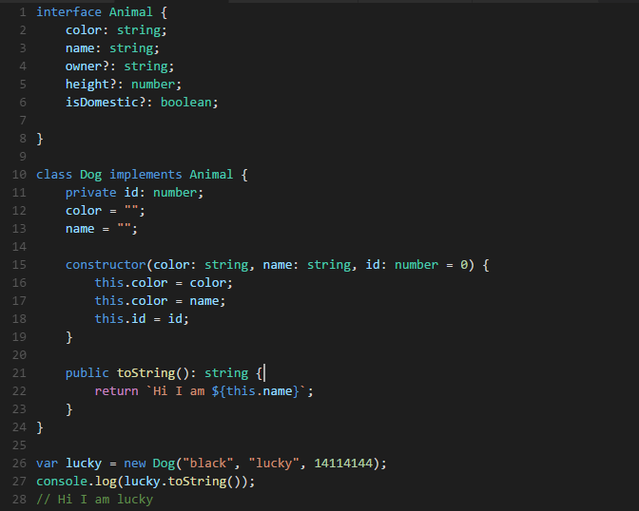
Classes

Slide 16
Class Inheritance
In TypeScript, we can use common object-oriented patterns. One of the most fundamental patterns in class-based programming is being able to extend existing classes to create new ones using inheritance.
Class inheritance is done via the extends keyword.
Inheritance is based on prototype inheritance.
Interface implementation is done via the implements keyword.

Slide 17
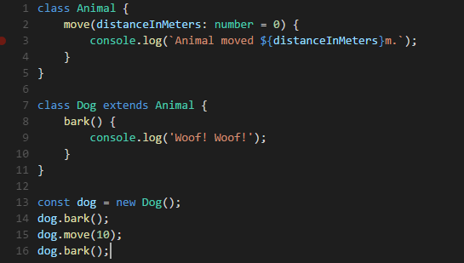
Class Inheritance
Examples

Slide 18
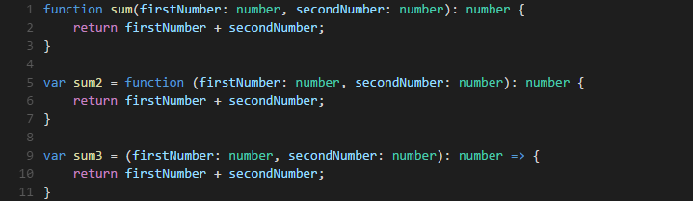
Functions
Just as in JavaScript, TypeScript functions can be
created both as a named function or as an anonymous
function.

Slide 19
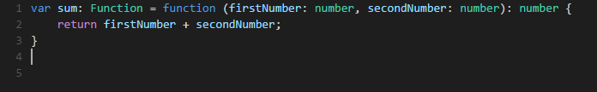
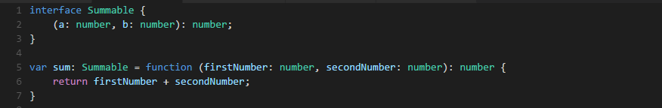
Function Type
There are several ways to define function type

Slide 20
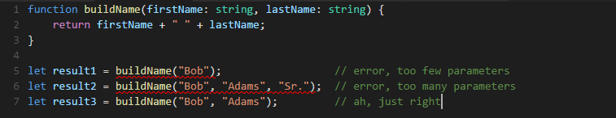
Functions optional & default parameters
In TypeScript, every parameter is assumed to be required by the
function.
This doesn’t mean that it can’t be given null or undefined.
The compiler also assumes that these parameters are the only
parameters
that will be passed to the function.
In short, the number of arguments given to a function has to
match the number of parameters the function expects.

Slide 21
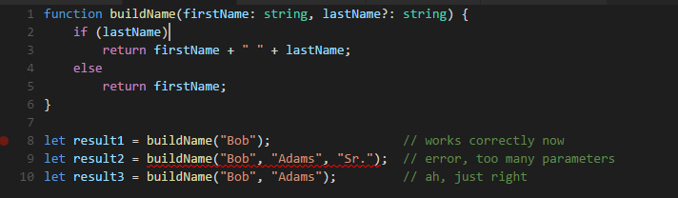
Functions optional & default parameters
In JavaScript, every parameter is optional, and users may leave them off as
they see fit.
When they do, their value is undefined.
We can get this functionality in TypeScript by adding a ? to the end of
parameters we want to be optional.
For example, let’s say we want the last name parameter from
above to be optional:

Slide 22
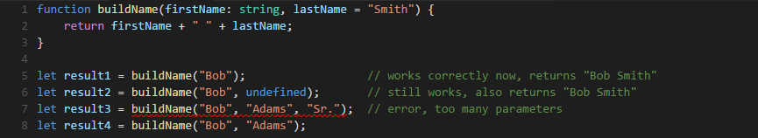
Functions optional & default parameters
In TypeScript, we can also set a value that a parameter will be assigned if the user does not provide one, or if the user passes undefined in its place.
These are called default-initialized parameters.
Let’s take the previous example and default the last name to "Smith".

Slide 23
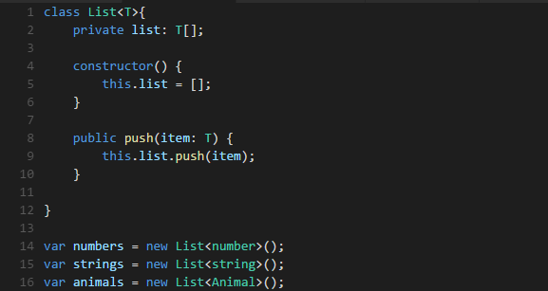
Generics
A major part of software engineering is building components that not only have well-defined and consistent APIs, but are also reusable.
Generics is the capability to create components that can work with a variety of types.
TypeScript’s generics does not transpile to anything special than a regular object.

Slide 24
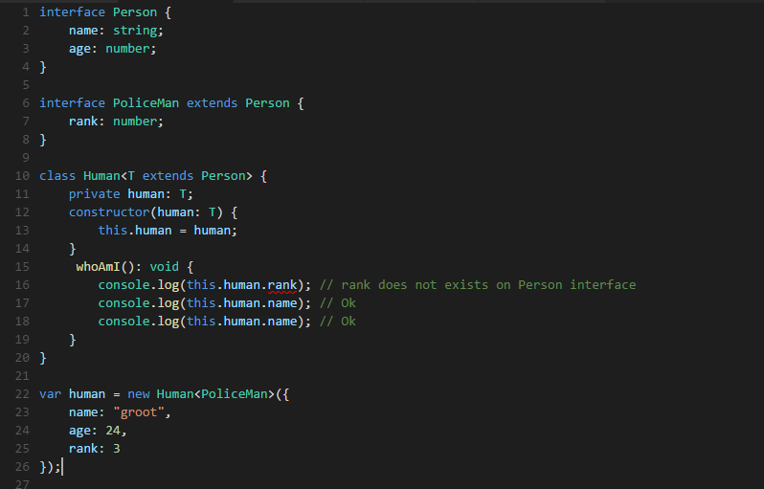
Generic Constraints
Sometimes you want to write a generic function or class that works on a set of types where you have some knowledge about what capabilities that set of types will have.
The generic type can have constraints which will allow only specific types to be used as the types.

Slide 25
